Slide 1
Reading Alan Turing’s papers
Avi Wigderson
Institute for Advanced Study

Slide 2
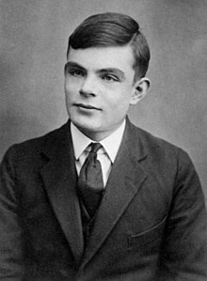
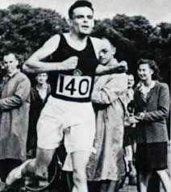
Alan Turing 1912-1954
1931-33 Undergrad, Kings’ college, Cambridge
1934-36 Fellow, Kings’ college, Cambridge
1937-38 Grad, Princeton, Alonso Church, PhD
1939-45 Hut 8, Bletchley Park, Enigma
1945-48 NPL, London, ACE computer
1949-54 Victoria University, Manchester
A paper or two from each period, and related TCS work.
Not mention: Computers, programming, Central Limit Theorem, LU decomposition, Encryption, Chess, Riemann Hypothesis, …
Notes:
Morphogenesis

Slide 3
The birth of TCS
Cambridge, Kings College, Fellow 1934-36
[Turing ’1936] On computable numbers, with an
application to the Entscheidungsproblem

Slide 4
On computable numbers, with an application to the Entscheidungsproblem
Max Newman’s course ``Foundations of mathematics”
[Hilbert’1928] program: Fix a theory T for math (eg PA)
T is complete
T is consistent
T provability decidable by a ``mechanical procedure”
Scooped: [Church’1936]
Max Newman → Editor, Journal of London Math Society:
``Publish: Proofs different, fundamental results need such”
Max Newman → Alonso Church:
``Please take Turing as your grad student in Princeton”
--------------- [Gödel’1931a]
--------------- [Gödel’1931b]
-----------------------------------------------------------
[Turing’1936]
?
Notes:
Turing’s paper scooped a similar TM model of Post (w/out Universal computer or Decision problem)

Slide 5
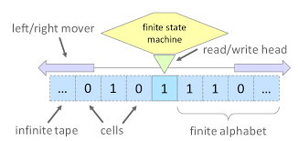
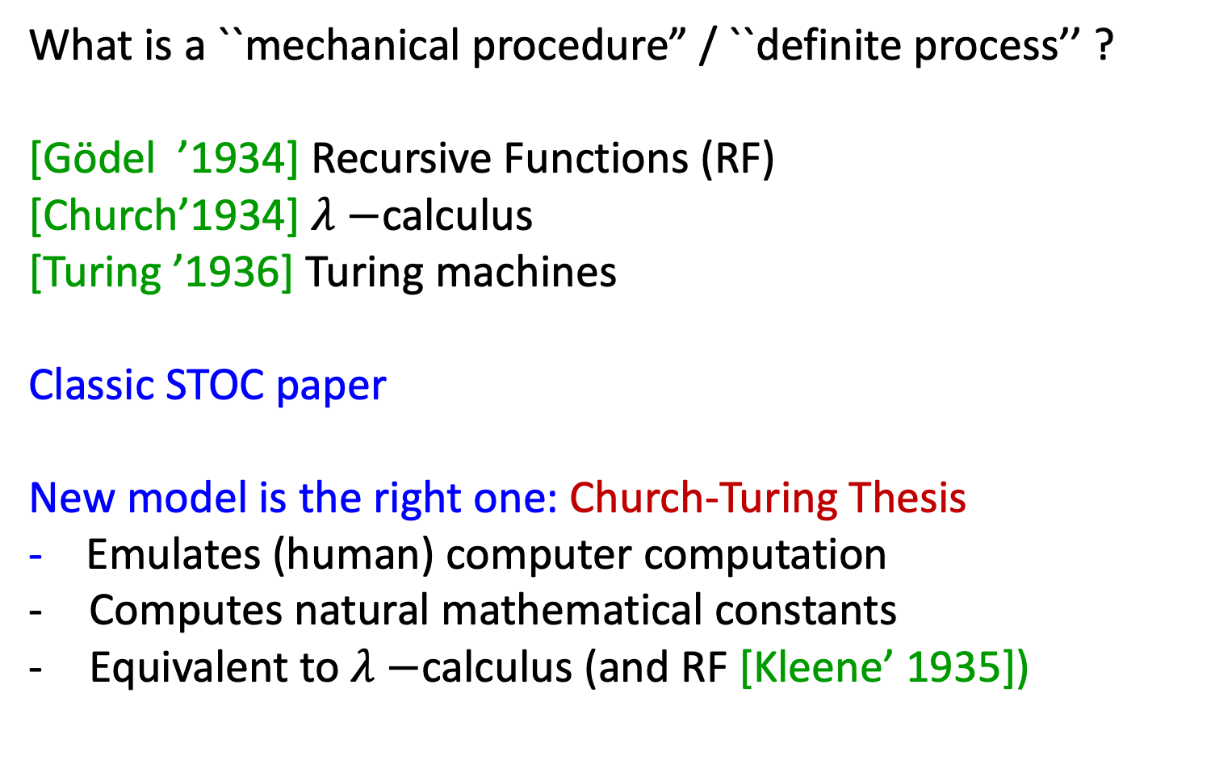
What is computation?
What is a ``mechanical procedure” / ``definite process’’ ?
[Gödel ’1934] Recursive Functions (RF)
[Church’1934] $λ−$calculus
[Turing ’1936] Turing machines
Classic STOC paper
New model is the right one: Church-Turing Thesis
- Emulates (human) computer computation
Computes natural mathematical constants
Equivalent to $λ−$calculus (and RF [Kleene’ 1935])
Notes:
Turing disappointed – only 2 requests for offprints. The paper took time to be dijested

Slide 6
Birth of TCS
[Turing’1936] Turing machines
Formal model: TCS is born
as a mathematical discipline
Complexity theory: Time & Space can be quantified
[Hartmanis-Stearns’64] DTIME(t(n)), DSPACE(S(n))
…
[Aaronson’02] ….Complexity zoo….
Notes:
Turing disappointed – only 2 requests for offprints. The paper took time to be dijested

Slide 7
Decidability & Undecidability
[Turing’1936]
No algorithm for the Halting problem!
=
Debugging programs is impossible!
[Papadimitriou] ``CS was born aware of its limitations!”
Math: Which problems can be understood?
Decidable: Algorithms
[Tarsky’51] 1st-order theory of the Reals (quant. Elimination)
[Haken’61] Knot un-knottedness (normal surfaces)
Undecidable: Reductions
[Turing, Markov, Post’ 50] Word problem in semi-groups
[Novikov, Boone, Britton’55] Word problem in groups
[Matiyasevich’70] Diophantine equations (Hilbert’s 10th)
Notes:
Turing disappointed – only 2 requests for offprints. The paper took time to be dijested

Slide 8
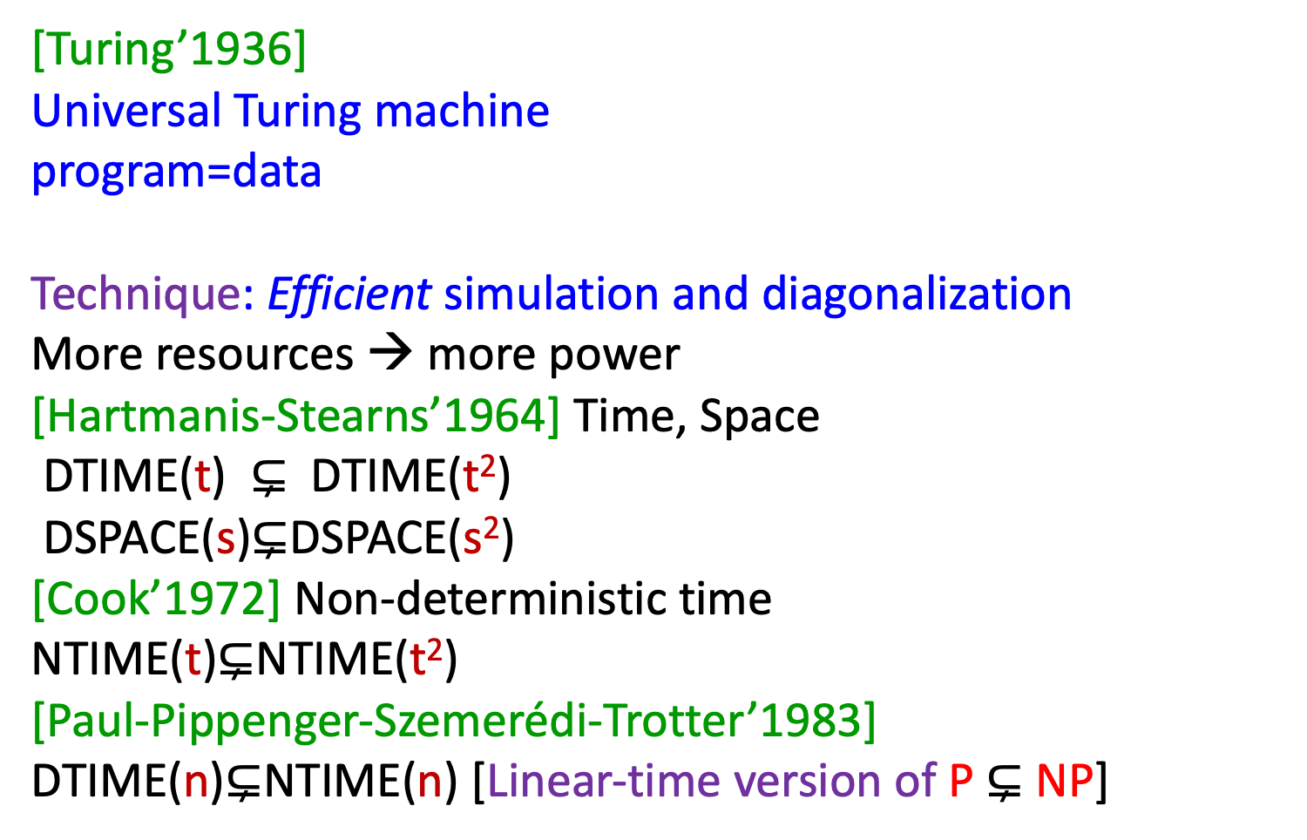
Lower bounds
[Turing’1936]
Universal Turing machine
program=data
Technique: Efficient simulation and diagonalization
More resources → more power
[Hartmanis-Stearns’1964] Time, Space
DTIME(t) $⊊$ DTIME(t²)
DSPACE(s)$⊊$DSPACE(s²)
[Cook’1972] Non-deterministic time
NTIME(t)$⊊$NTIME(t²)
[Paul-Pippenger-Szemerédi-Trotter’1983]
DTIME(n)$⊊$NTIME(n) [Linear-time version of P$⊊$ NP]
Notes:
Turing disappointed – only 2 requests for offprints. The paper took time to be dijested

Slide 9
Non-deterministic machines and proof systems
``If at each stage the motion of a machine is completely determined by the configuration, we shall call the machine an "automatic machine" (or a-machine).’’
``For some purposes we might use machines (choice machines or c-machines) whose motion is only partially determined by the configuration. When such a machine reaches one of these ambiguous configurations, it cannot go on until some arbitrary choice has been made by an external operator. This would be the case if we were using machines to deal with axiomatic systems.’’

Slide 10
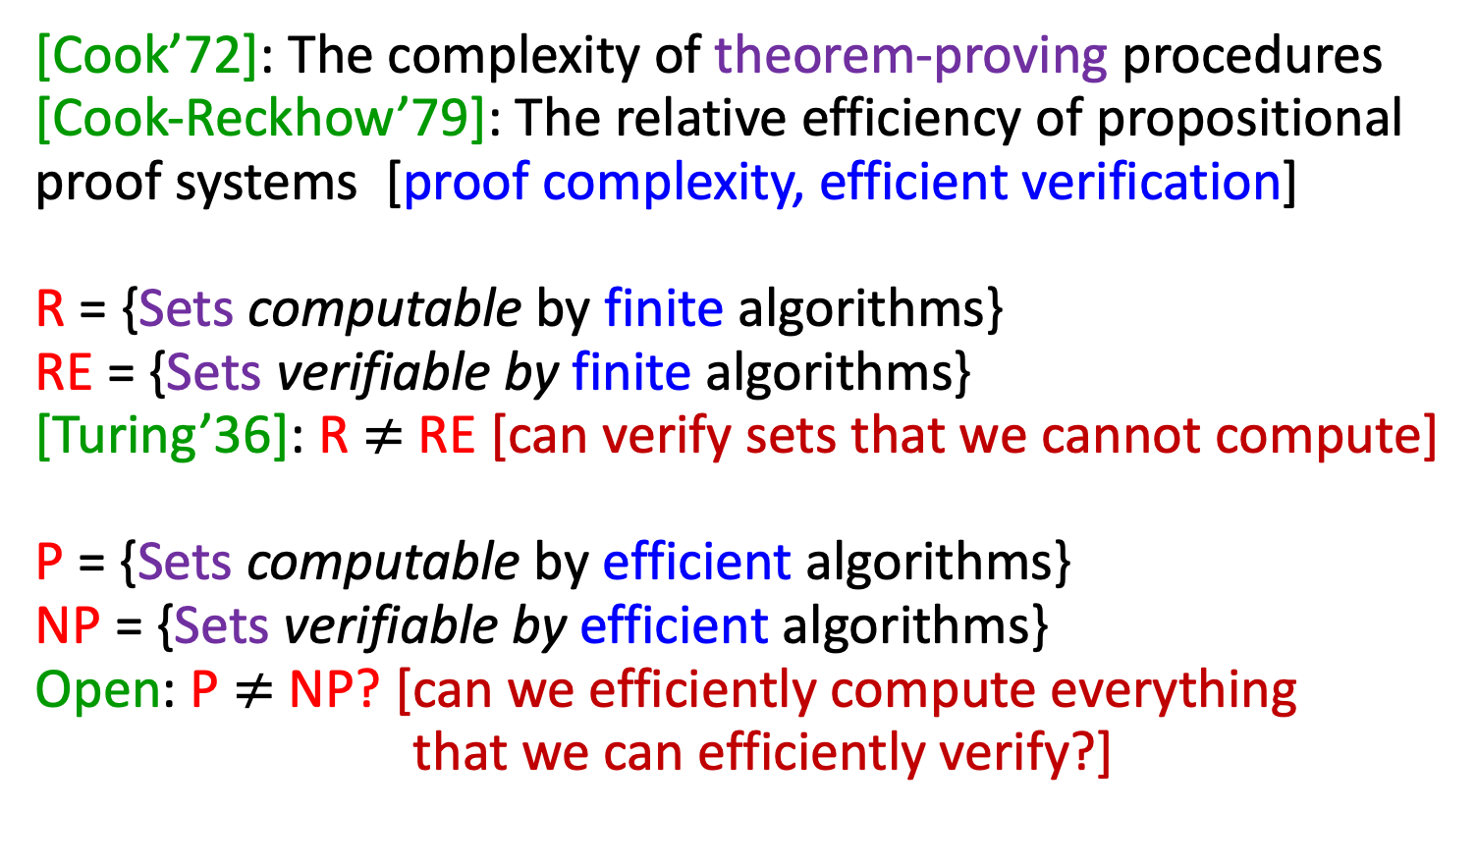
Verification vs. Computation
[Cook’72]: The complexity of theorem-proving procedures
[Cook-Reckhow’79]: The relative efficiency of propositional
proof systems [proof complexity, efficient verification]
R = {Sets computable by finite algorithms}
RE = {Sets verifiable by finite algorithms}
[Turing’36]: R $≠$ RE [can verify sets that we cannot compute]
P = {Sets computable by efficient algorithms}
NP = {Sets verifiable by efficient algorithms}
Open: P $≠$ NP? [can we efficiently compute everything
that we can efficiently verify?]

Slide 11
Efficient verification galore
[Cook,Karp,Levin’72] NP
[Arora-Lund-Motwani-Safra-Sudan-Szegedy’92] NP = PCP
[Babai, Goldwasser-Micali-Rackoff’85] IP
[Lund-Fortnow-Karloff-Nisan, Shamir ’90] IP = PSPACE
[BenOr-Goldwasser-Kilian-Wigderson ‘89]. MIP
[Babai-Fortnow-Lund ’91] MIP = NEXP
[Watrous’99] IP*
[Jain-Ji-Updahyay-Watrous’09] IP*= PSPACE
[Cleve-Hoyer-Toner-Watrous’04] MIP*
[Ji-Natarajan-Vidick-Wright-Yuen’20] MIP* = RE

Slide 12
Oracles & Relative computation
Princeton University, PhD 1937-38
(Church, Kleene, Rosser, von Neumann, Gödel,…)
[Turing ’1939] (PhD thesis)
Systems of logic based on ordinals
Notes:
Trying to get around Godel’s incompleteness. Gave 1 lecture in 2 years

Slide 13
Oracle machines
(and Turing redudctions)
"Let us suppose that we are supplied with some unspecified means of solving number-theoretic problems; a kind of oracle as it were .... With the help of the oracle we could form a new kind of machine (call them o-machines), having as one of its fundamental processes that of solving a given number-theoretic problem.”
[Post’44] Turing degrees
``Now in his paper on ordinal logics [26, section 4], Turing presents as a side issue a formulation which can immediately be restated as the general formulation of the "recursive reducibility" of one problem to another, and proves a result which immediately generalizes to the result that for any "recursively given" unsolvable problem there is another of higher degree of unsolvability.’’

Slide 14


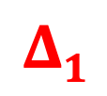
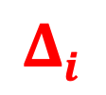


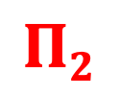
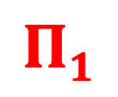
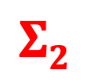

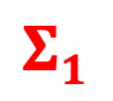
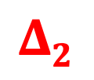
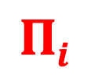

Relative computation degrees of unsolvability
[Kleene’43, Post’44 , Mostowski’46]
Arithmetic hierarchy
Distinct
[Meyer-Stockmeyer’76] C→C^{p}
Polynomial-time hierarchy
Oracle excuses
$$Σ i⎻1$$
$$Σ i⎻1$$
$Σ1$ =
$$Σi$$
$$Πi$$
$Σ1$ =
$$Σi$$
$$Πi$$
$$Δi$$
$$Δi$$
$$Σ2$$
$$Π2$$
$$Σ2$$
$$Π2$$
$$Δ2$$
$$Δ2$$
RE=
$$Σ1$$
$$Π1$$
=co-RE
NP=
$$Σ1$$
$$Π1$$
=co-NP
R=
$$Δ1$$
P=
$$Δ1$$

Slide 15
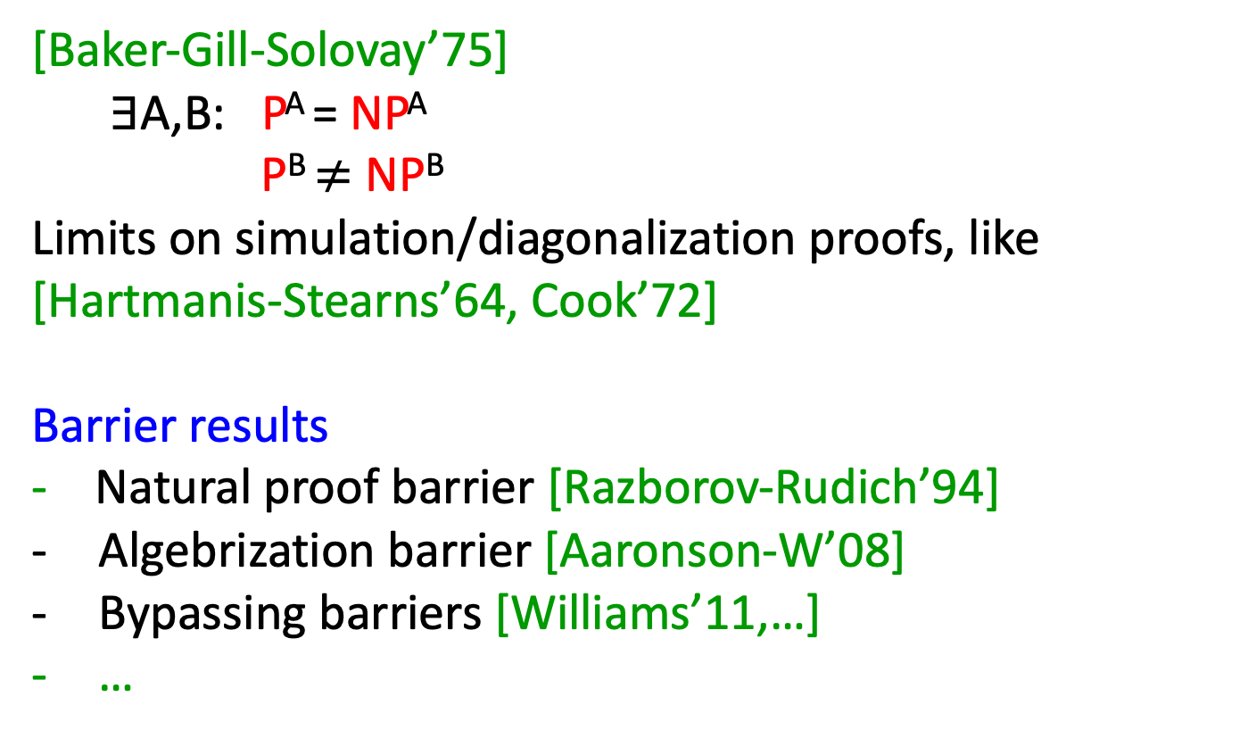
Relativization – limits on diagonalization
Barrier results, introspection
[Baker-Gill-Solovay’75]
$∃$A,B: P^{A} = NP^{A}
P^{B} $≠$ NP^{B}
Limits on simulation/diagonalization proofs, like
[Hartmanis-Stearns’64, Cook’72]
Barrier results
- Natural proof barrier [Razborov-Rudich’94]
Algebrization barrier [Aaronson-W’08]
Bypassing barriers [Williams’11,…]
…

Slide 16
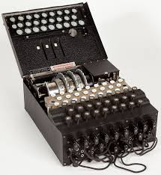
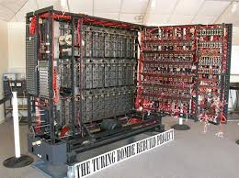
Code breaking
1939-1945 Hut 8, Bletchley Park
Churchill: The greatest single contribution to victory in WWII
Enigma
Bombe
Brute force search for the key
+ Theory

Slide 17
Probability, statistics and information theory
[Good’1950] Probability and the weight of evidence
[Good’1953] The population frequencies of species
and the estimation of population parameters
[Good’1953] ``The formula (2) was first suggested to me, together with an intuitive demonstration, by Dr A. M. Turing several years ago. Hence a very large part of the credit for the present paper should be given to him, and I am most grateful to him for allowing me to publish this work.’’
[Good’1985] Weight of evidence: a brief survey

Slide 18
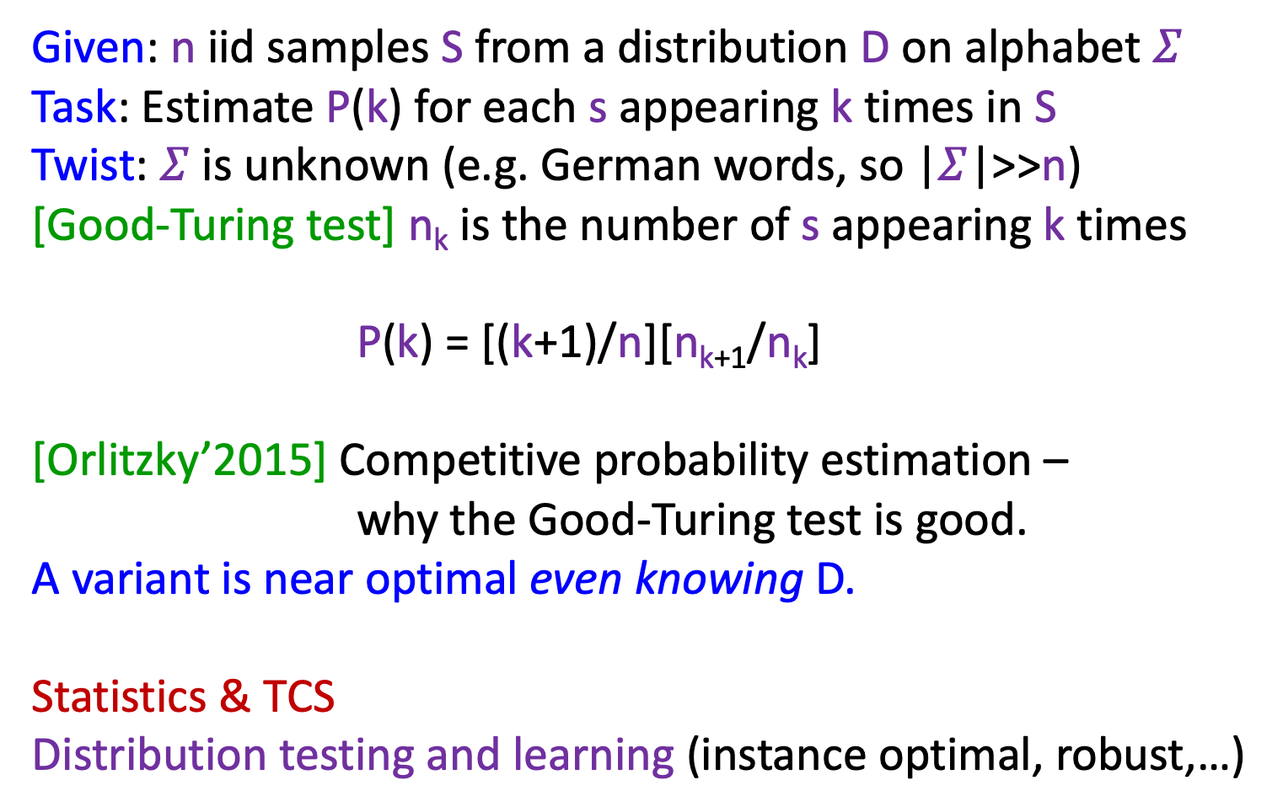
Estimating population frequencies
Given: n iid samples S from a distribution D on alphabet $Σ$
Task: Estimate P(k) for each s appearing k times in S
Twist: $Σ$ is unknown (e.g. German words, so |$Σ$|>>n)
[Good-Turing test] n_{k} is the number of s appearing k times
P(k) = [(k+1)/n][n_{k+1}/n_{k}]
[Orlitzky’2015] Competitive probability estimation –
why the Good-Turing test is good.
A variant is near optimal even knowing D.
Statistics & TCS
Distribution testing and learning (instance optimal, robust,…)

Slide 19
Weight of evidence
Given: Distributions P, Q, Sample x from P
Question: How much does x confirm P over Q
W(P:x): log P(x)/Q(x)
[Turing’1940] Consider the distribution of W under P
Expectation: KL-divergence. Higher moments.
Hypothesis testing, Sequential analysis [Wald’1945]
Practice: Sequentially update search for Enigma keys. Crucial to efficiency of the Bombes and breaking Nazi Naval Enigma.
Theory: identities and inequalities on the distribution of W, many credited to Turing in Good’s book and papers.
Notes:
Sequential analysis (Wald…- quality control during WWII)) –On0line statistics (where sample size is not fixed)

Slide 20
Intelligence / Machine Learning
Victoria University, Manchester, 1949-54
(Manchester computer project)
1953: Appointed “Reader of Theory of Computation”
[Turing ’1950] Computing machinery and intelligence

Slide 21
Probabilistic algorithms
An interesting variant on the idea of a digital computer is a "digital computer with a random element”. These have instructions involving the throwing of a die or some equivalent electronic process; one such instruction might for instance be, "Throw the die and put the resulting number into store 1000.”
Suggested random sources in other papers:
Thermal noise, Roulette wheel, Radium,…

Slide 22
Pseudo-randomness
`` It is not normally possible to determine from observing a machine whether it has a random element, for a similar effect can be produced by such devices as making the choices depend on the digits of the decimal for π.’’
[Goldreich-Goldwasser-Micali’ 86] How to construct random functions.
``I have set up on the Manchester computer a small programme using only 1,000 units of storage, whereby the machine supplied with one sixteen-figure number replies with another within two seconds. I would defy anyone to learn from these replies sufficient about the programme to be able to predict any replies to untried values.’’

Slide 23
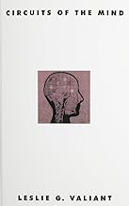
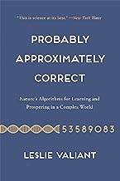

Machine learning, education
How can machines learn, brain analogies:
“What we want is a machine that learns from
experience. The possibility of the machine changing
its own instructions provides the mechanism for that.”
Tolerance to errors: “If a machine is expected to be infallible, then it cannot be intelligent”
Analogy with child learning:
``We may notice three components,
The initial state of the mind, say at birth,
The education to which it has been subjected,
Other experience...to which it has been subjected.”

Slide 24
Intelligence
[Turing’1950] Computing machinery and intelligence
How to study the question “can machines think?”
Define machine & think. (philosophical/ontological)
Test it! (operational/behavioral)
1) Objective, ontological definitions may not be testable, falsifiable, have universal meaning, …
2) Subjective, behavioral definitions may be precise, testable, operational, useful, ..., revolutionary

Slide 25



Turing’s test: the imitation game
[Turing ‘50]
p₀
p₁
“Definition”: Robot is intelligent if
for every human referee,
p₀
≈
p₁

Slide 26
TCS: Precise Imitation Games
Paradigm: two things are the same if they cannot be told apart by any reasonable test
Right definitions of central notions - primary
Theorems, proofs, constructions - follow
Power of the Imitation Game paradigm:
enables math, science, technology, policy!
Examples: Crypto, Pseudorandomness, Privacy,…

Slide 27
Cryptography

Slide 28
Secure encryption
[Goldwasser-Micali ’81]
Enc(m₀)
Enc(m₁)
Efficient
algorithm A
Efficient
algorithm A
p₀
p₁
Definition: Enc is secure if for every m₀ & m₁
and for every efficient algorithm,
p₀
≈
p₁

Slide 29
MPC (e.g. secure elections)
[Yao’86, Goldreich
-Micali-W ’87]
Government
Internet
Ideal
Protocol
Eff. algorithm A
Eff. algorithm A
p₀
p₁
Definition: Protocol is secure if for every efficient algorithm, and every subset of players,
p₀
≈
p₁

Slide 30
Randomness

Slide 31


Computational pseudo-randomness
[Shamir’80, Blum-Micali ’81, Yao’82]
Efficient
algorithm A
Efficient
algorithm A
p₀
p₁
Definition: is pseudo-random
if for every efficient algorithm,
p₀
≈
p₁

Slide 32
Privacy

Slide 33

Differential Privacy
[Dinur-Nissim’03, Dwork-McSherry-Nissim-Smith’06]
Jane Doe
D₀
D₁
filter
filter
Query Q
Query Q
p₀
p₁
Definition: A filter is differentially private if for every adjacent D₀ & D₁ and every legal query,
p₀
≈
p₁

Slide 34
Morphogenesis
Victoria University, Manchester, 1949-54
[Turing ’1952] The chemical basis of morphogenesis

Slide 35
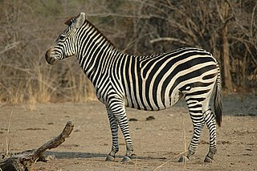
Morphogenesis
We all start from a fertilized egg – symmetric, homogeneous
What explains the stripes?
The legs, head, tail, body direction…?
How does asymmetry arise from perfect symmetry?
How does structure arise from asymmetry?
…

Slide 36
The chemical basis of morphogenesis
``In this section a mathematical model of the growing embryo will be described. This model will be a simplification and an idealization, and consequently a falsification. It is to be hoped that the features retained for discussion are those of greatest importance in the present state of knowledge.’’

Slide 37
The chemical basis of morphogenesis
``It is suggested that a system of chemical substances, called morphogens, reacting together and diffusing through a tissue, is adequate to account for the main phenomena of morphogenesis. Such a system, although it may originally be quite homogeneous, may later develop a pattern or structure due to an instability of the homogeneous equilibrium, which is triggered off by random disturbances. Such reaction-diffusion systems are considered in some detail in the case of an isolated ring of cells, a mathematically convenient, though biologically, unusual system. The investigation is chiefly concerned with the onset of instability. It is found that there are six essentially different forms which this may take. In the most interesting form stationary waves appear on the ring.’’

Slide 38
Reaction-Diffusion model
Ring/Sphere of cells (discrete/continuous)
State: quantities of morphogens in each cell
Reaction-Diffusion model
- Chemical reactions inside each cell
- Diffusion between neighboring cells
Initial: symmetric, homogeneous equilibrium
Computational lens
``With either of the models one proceeds as with a physical theory and defines an entity called 'the state of the system'. One then describes how that state is to be determined from the state at a moment very shortly before.’’
Transition: quantities change with reaction & diffusion
Over time; instability, symmetric breaks, structure emerges
e.g. clusters, stationary/oscillatory waves,…
Notes:
Simplest possible model, two morphogenes, with different diffusion rates

Slide 39
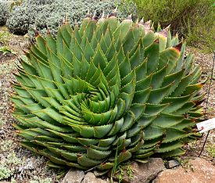
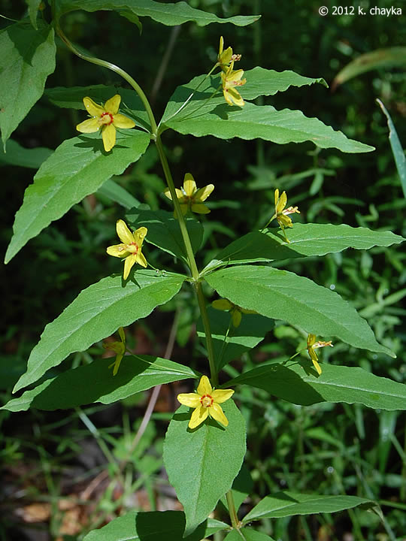
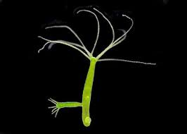

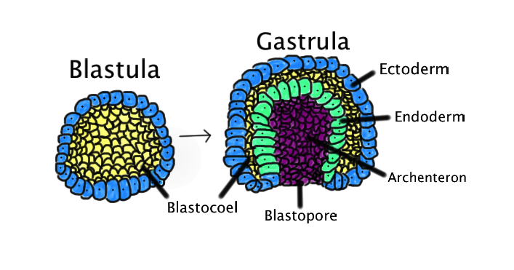


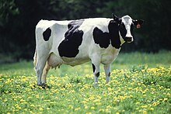
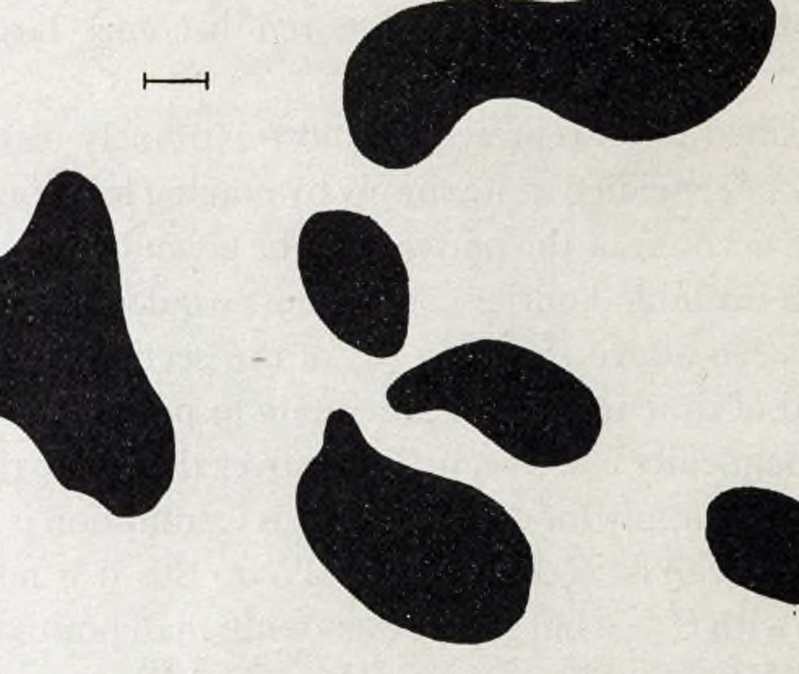
Morphogenesis
Model
Phylotaxis: Whorled leaves
Hydra tentacles
Gastrulation
Cellular
automata
Dappling
simulation

Slide 40
The computational lens
Biology: Computational biology, Neuroscience,…
Economics: Game theory, Mechanism design,…
Social science: Social networks, Privacy, Fairness,…
Physics: Statistical physics, Quantum Mechanics, Gravity,…
Math: Analysis, Algebra, Geometry, Number Theory,…
Collaboration, joint conferences, cross-fertilization,…
integrating computation theory to every model

Slide 41
Summary
Read these papers!
A great thinker, with a huge impact!
Scientist, mathematician, philosopher, engineer,…
Deep contemplation of a stunning variety of fundamental issues. Fearlessness
Deep desire to understand these, theoretically.
Critical judgement (many papers contain critique and answers to it). Brutally honest.
Clear logical thinking, clear exposition of it.
Simplest models and simplest justification.
Does not rush to publish.

Slide 42
Book ad
- Published by Princeton University Press
- Free (forever) on my website
- Comments welcome!

