Slide 1
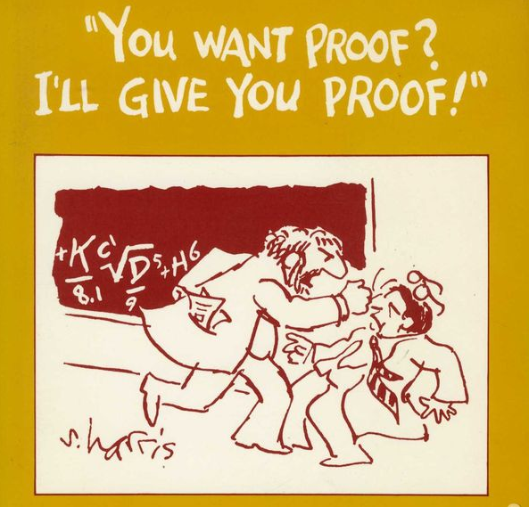
The value of errors in proofs the fascinating journey from Turing’s 1936 R$≠$RE to the 2020 breakthrough MIP*=RE
Avi Wigderson
Institute for Advanced Study

Slide 2
Plan
Proofs and computations
The value of errors in computations
The value of errors in proofs: impact on
Science: CS, Optimization, Coding…
Technology: Crypto, Clouds, Blockchains,…
Conceptual: Nature, paradoxical properties of proofs
Math: Proof systems encode mathematical objects
The value of the complexity theory methodology
Modelling, algorithmic efficiency, classification, …

Slide 3
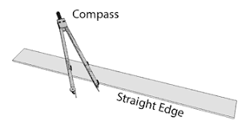
Proofs and Computations Two points in a very long history
[Euclid, 300BC]: The Elements
{Proofs of theorems in Plane Geometry, deducible from 5 simple axioms}
=
{Constructions of planar point sets using Straightedge and Compass}

Slide 4
Turn of the 20th century
Hilbert’s dream: Truth = Provability = Computability
…shattered
[Gödel ’31] Incompleteness Thm (= is wrong)
[Turing ’36] Undecidability Thm (= is wrong)
Def: algorithms $↔$Turing Machines
Set S $↔$ Decision Problem { “is x $∈$ S ?” }
R = {Sets computable by finite algorithms}
RE = {Sets provable to finite algorithms}
Thm: R $≠$ RE
P = {Sets computable by efficient algorithms}
NP = {Sets provable to efficient algorithms}
Open: P $≠$ NP?
Corollary:
Computer
revolution
Polynomial time

Slide 5
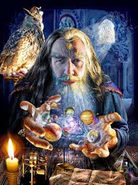
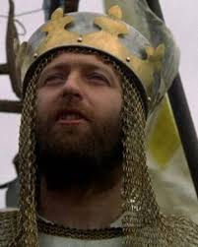
Examples: claims, arguments, proofs, proof systems, provers, verifiers…
What is a convincing argument?
Claim:
“x $∈$ S”
Prover
Verifier
argument
- Infinitely clever
- Cannot be trusted
- Eager to know
- Limited

Slide 6
Composite numbers
Claim: 147573952588676412927 is composite
Argument: 193707721, 761838257287
Verification: Check if
193707721 x 761838257287 = 147573952588676412927
ACCEPT/REJECT
Crypto rests on the difficulty of finding such
General
Efficient algorithm: simple arithmetic
Theorems = {Composite numbers}

Slide 7
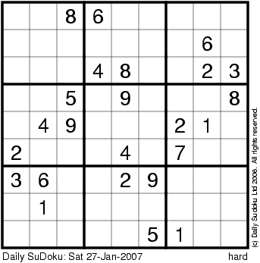
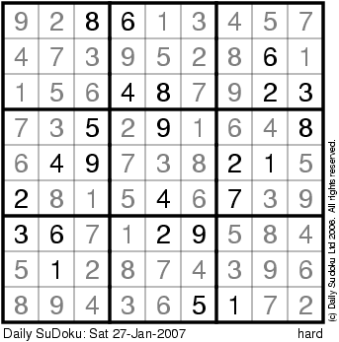
Sudoku
Claim: This puzzle is solvable
Argument:
Verification: Check each row, column, square,
AND that consistent with input. ACCEPT/REJECT
General
Efficient: simple pattern matching
Theorems = {Solvable Sudoku puzzles}

Slide 8
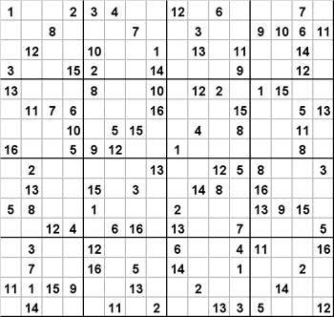
Notes:
Complexity of solutions increases with data size

Slide 9
Deductive proof systems e.g. Peano Arithmetic
Numerous
others
Objects: Formulas/expressions over integers (A,B,..)
Axioms: E.g.
- x+y = y+x
- x+1 > x
- (x+y)z = xz+yz
Induction Principle
Deduction rules: E.g. if A, A→B true, then B is true.
Argument (for claim C): A₁, A₂,…, A_{m} = C
Verification: Check that each A_{i} is an axiom, or follows
from previous ones by a deduction rule. ACCEPT/REJECT
Theorems: {There are infinitely many primes,
Fermat’s last theorem: no solution to x^{n}+y^{n}=z^{n,} n>2, …}
Notes:
You’ve got to believe/trust something!
Proofs are reductions of complex statements
to simple truths via simple local sound steps

Slide 10
Essentials of proof systems
Completeness: True claims have proofs
Soundness: False claims don’t
Easy to check: Distinguishing convincing and faulty arguments by an efficient Verifier algorithm
A complexity theoretic view
Time=poly(|claim|)
Notes:
Pragmatic view. Annals – Tom Hayes “Kepler’s conjecture”,

Slide 11
Proof System [Cook-Reckhow ’79]
An efficient Verifier V(claim, argument) satisfies:
Completeness: If claim is true then, for some argument
V(claim, argument) = ACCEPT
(in which case claim=theorem, argument=proof)
Soundness: If claim is false then, for every argument
V(claim, argument) = REJECT
T_{V} : the set of theorems in this system.
[CR’79] NP = {T_{V} : V deterministic}
= { {Solvable Sudoku puzzles}, {Composite numbers},…}
$⊇$ P = {T_{V} : V deterministic, ignores argument}

Slide 12
Errors in Probabilistic Proofs (and Computations)

Slide 13
Probabilistic computation & error
“Axiom”: Nature provides free access to randomness
(so, let algorithms make random choices!)
Def: A deterministic algorithm A computes a function f if
for all x, A(x) = f(x) always
Def: A probabilistic algorithm B computes a function f if
for all x, B(x) = f(x) WHP (eg > 2/3)
Error can be efficiently reduced arbitrarily!
Pr[B(x) $≠$ f(x)] < 1/3 ➔ $∀$k, Pr[B_{k}(x) $≠$ f(x)] < exp(-k)
Value of allowing errors: Seem to solve more problems, ++
Rationale for allowing errors:
We tolerate uncertainty in life, why not in algorithms?
errors in algs

Slide 14
Probabilistic Proof System [Babai ‘85, Goldwasser-Micali-Rackoff ‘85]
probabilistic
An efficient Verifier V(claim, argument) satisfies:
Completeness: If claim is true then, for some argument
V(claim, argument) = ACCEPT
(in which case claim=theorem, argument=proof)
Soundness: If claim is false then, for every argument
V(claim, argument) = REJECT
T_{V} : the set of theorems in this system.
IP $≜$ {T_{V} : V probabilistic + interactive}
WHP
WHP
errors in proofs

Slide 15
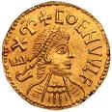
IP = (Probabilistic) Interactive Proofs
[Babai’85, Goldwasser-Micali-Rackoff’85]
claim
Prover
Verifier (deterministic)
argument
argument
ACC/REJ
correctly
always
NP
Prover
q₁
Verifier (probabilistic)
IP
a₁
ACC/REJ
correctly
WHP
……
q_{r}
Reasonable
a_{r}
A revolutionary scientific notion!
Notes:
Babai had a group theory motivation – extending the computational power of NP
GMR had a crypto motivation. In particular allow proofs to posses new properties like ZK

Slide 16
Value of errors in proofs: Impact of interactive proofs
Conceptual, Mathematical,
Scientific, Technological,…
Proofs with paradoxical properties
ZK: Convincing proofs need not convey information
PCP: Convincing proofs need only be glanced at
The meandering journey from ZK to PCP
and from IP to MIP to MIP*
Notes:
Problem is NP complete, but this is no lower bound

Slide 17
ZKIP: Zero-Knowledge Interactive Proofs
[Goldwasser-Micali-Rackoff ’85]
claim
q₁
ZKIP = IP +
Prover
Verifier
ZKIP
a₁
V ACC. →
V learns
nothing else
……
q_{r}
Formal def
non-trivial!
a_{r}
Possible? Can a convincing proof be uninformative?
Fermat’s last theorem?
Riemann Hypothesis?
Anything?

Slide 18
ZKIP: Zero-Knowledge Interactive Proofs
[Goldwasser-Micali-Rackoff ’85]
claim
q₁
ZKIP = IP +
Prover
Verifier
ZKIP
a₁
V ACC. →
V learns
nothing else
……
q_{r}
Formal def
non-trivial!
a_{r}
Possible? Can a convincing proof be uninformative?
[Goldreich-Micali-Wigderson ’86]
1-way functions exist → NP ⊆ ZKIP
Every proof can be made into a ZK proof!

Slide 19
ZK impacts
Theory: [Yao ‘86, Goldreich-Micali-Wigderson ’87,…]
Automating secure cryptographic protocol design for multiple players and arbitrary constraints
Practical applications:
Anonymous cash, Blockchains, Public ledgers …
Physical ZK proofs:
[Barak-Glaser-Goldstone’14] Nuclear disarmament
[Fisch-Freund-Naor ’14] Anonymous DNA testing,…
New proof systems:
MIP: allowing multiple provers

Slide 20
ZKIP: Zero-Knowledge Interactive Proofs
[Goldwasser-Micali-Rackoff ’85]
claim
q₁
ZKIP = IP +
Prover
Verifier
ZKIP
a₁
V ACC. →
V learns
nothing else
……
q_{r}
Formal def
non-trivial!
a_{r}
[Goldreich-Micali-Wigderson ’86]
1-way functions exist → NP ⊆ ZKIP
Every proof can be made into a ZK proof!
Crypto is used! Is it necessary?
Yes & No

Slide 21
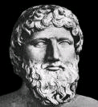
2IP: 2-Prover Interactive Proofs (& MIP)
[BenOr-Goldwasser-Kilian-Wigderson ‘89]
2IP
claim
Reasonable?
q₁
p₁
Prover₁
a₁
Verifier
b₁
Prover₂
……
q_{r}
……
p_{r}
a_{r}
b_{r}
Socrates
Correctly
ACC/REJ WHP
Plato
[BGKW ‘89] NP ⊆ ZK 2IP
Physical separation replaces
computational assumptions
Notes:
Motivation for defining 2IM was Zero-Knowledge !

Slide 22
What is the power of Randomness and Interaction in Proofs?
Trivial inclusions
IP ⊆ PSPACE
2IP ⊆ NEXP
2IP
Polynomial Space
Nondeterministic
Exponential Time
IP
NP
Notes:
Even though the zero-knowledge issue was resolved, the basic question of the power of these classes, IP and 2IP remained.

Slide 23
Avalanche of Characterizations
& their conceptual meaning
[Lund-Fortnow-Karloff-Nisan, Shamir ’90] IP = PSPACE
Winning strategies are efficiently verifiable!
[Babai-Fortnow-Lund ’91] 2IP = NEXP
Intractable problems are efficiently verifiable!
Exponentially long arguments convince efficient verifiers!
[Arora-Lund-Motwani-Safra-Sudan-Szegedy’92] PCP = NP
Written proofs verifiable from constant-size snapshots!
No crypto!
Notes:
Problem is NP complete, but this is no lower bound

Slide 24
PCP: Probabilistically Checkable Proofs
Not interactive!
claim
Prover
Verifier (probabilistic)
argument
ACC/REJ
Correctly WHP
PCP
Reads only 20 bits
of the argument
Possible? Finding a single bug in a 100-page proof?

Slide 25
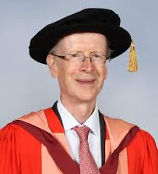
PCP (Probabilistically Checkable Proofs)
Riemann Hypothesis
claim
Prover
Verifier (probabilistic)
argument
ACC/REJ
Correctly WHP
Reads only 20 bits
of the argument
NP=PCP
PCP
PCP
Reads only 20 bits
of the argument
[ALMSS’92]
Possible? Finding a single bug in a 100-page proof?
Every proof can be efficiently turned into a PCP!
Refereeing any paper in seconds!!
Optimization Hardness of approximation
Coding theory
Complexity theory,…
Technology: cloud computing, blockchains,…

Slide 26
Back to Probabilistic Interactive Proofs
Quantum
[Lund-Fortnow-Karloff-Nisan, Shamir ’90]
IP = PSPACE
[Babai-Fortnow-Lund ’91] 2IP = NEXP
Notes:
Problem is NP complete, but this is no lower bound

Slide 27
Quantum computation
“Axiom”: Nature provides access to quantum phenomena
[Manin ’80, Feynman ‘82] Suggest building computers, that manipulate quantum superpositions with unitary operations.
[…, Deutsch ’85,…, Bernstein-Vazirani ’93,…] Formalize it.
BQP: efficient quantum algorithms ( > BPP probabilistic ones)
[Shor ‘94] Factoring, Discrete Log $∈$ BQP
Frenzy attempts to develop:
- Supporting technology (billions of $$ invested)
“Post-quantum” cryptography (e.g. hardness assumptions)
New quantum algorithms (not so much…)
New models (plenty)

Slide 28
Quantum proof systems
Verifier is an efficient quantum algorithm
[Watrous’99] One prover: IP*
[Jain-Ji-Updahyay-Watrous’09] IP* = IP = PSPACE
[Cleve-Hoyer-Toner-Watrous’04] Many provers: MIP*
[Ito-Vidick’12] MIP*$⊇$ MIP = NEXP
[Natarajan-Wright’19] MIP*$⊇$NEEXP
[Ji-Natarajan-Vidick-Wright-Yuen’20] MIP* = RE
Counterexamples galore:
Quantum Information theory: to Tsirelson’s Problem
von-Neumann algebras: to Connes’ Embedding Conj.
Group theory: to Kirchberg’s QWEP Conjecture
EPR controversy of quantum mechanics, Bell Inequalities, power of entanglement,…

Slide 29
1-round proofs as Games [Cai-Condon-Lipton ’90]
$$r$$
Random string
NEXP =
Prover₁
Verifier
Prover₂
2IP
q₁
q₂
a₁
a₂
val(G): max Prob [Ver(q₁,q₂,a₁,q₂)=ACC]
best provers’ strategy
How hard is it to
approximate within
a constant factor?
Val*(G): max Prob [Ver(q₁,q₂,a₁,q₂)=ACC]
best provers’ strategy
Quantum state
$$ψ$$
Entangled
RE =
2IP*
Verifier
Prover₁
q₁
q₂
Prover₂
a₁
a₂
Notes:
Motivation for defining 2IM was Zero-Knowledge !

Slide 30
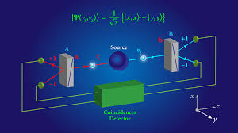
Physics Games [Einstein-Podolski-Rosen ’35 (IAS)]
$$r$$
“Hidden variables”
Random string
Prover₁
Verifier
Prover₂
2IP
q₁
q₂
a₁
a₂
Classical,
local game
val(G)
$$>$$
val*(G)
“Spooky action”
Quantum state
$$ψ$$
Entangled
2IP*
Prover₁
Verifier
Prover₂
q₁
q₂
Quantum,
nonlocal game
a₁
a₂
Notes:
Motivation for defining 2IM was Zero-Knowledge !

Slide 31
val(G): Classical game value
val*(G): Quantum game value
Physics [Einstein-Podolski-Rosen ’35]
Is quantum mechanics complete?
2-prover game
- Hidden variable?
- Spooky action
at a distance?
[EPR ’35, Bohm’51, Bell ‘64, CHSH ’67,…]
Examples of games G with val*(G) > val(G), Tests(!)
ToC [Cleve-Hoyer-Toner-Watrous ’04]
Suggest a complexity theory for all non-local games, MIP*
[CHTW’04,… IV’12,… NW’19,… JNVWY’20]
Reductions, amplification, completeness, codes, PCPs,…
Necessary for MIP* = RE, structural understanding, and refuting the Connes, Tsirelson, Kirchberg,… conjectures
Notes:
Motivation for defining 2IM was Zero-Knowledge !

Slide 32
Summary
- 50 shades of proof
Allowing interaction, randomness and errors in proofs lead to magical proof systems.
Theory predates and enables practical, scientific, mathematical & societal use.
Connections between subdisciplines
Power of the complexity theoretic methodology of computational modeling, algorithmic efficiency, classification, reductions, completeness, …

Slide 33
Book ad
- Published by Princeton University Press
- Free on my website
- Comments welcome!

