Slide 1
Alternate Minimization & Scaling Algorithms: Theory,Applications,Connections
Avi Wigderson
IAS, Princeton

Slide 2
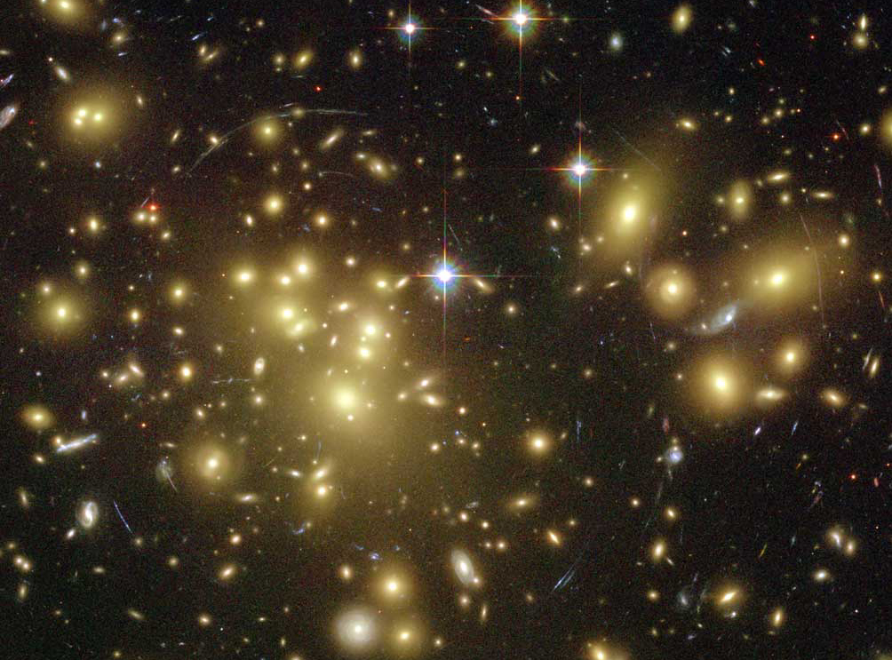
Scientific / Mathematical/ Intellectual /
Computational problems
NP: Problems we
want to solve/understand
P: Problems we can solve/understand
P=NP?
Notes:
We’ll try to put some structure in this universe.
Computational problems are often essential components of scientific, mathematical and other intellectual challenges.

Slide 3
Computation is everywhere
Unsolvable
EXP
Chess / Go
Strategies
NP
QP
SAT
Integer
Factoring
Pattern
Matching
NP-complete
Shortest
Path
Solving
Sudoku
Theorem
Proving
Error
Correction
P
FFT
Map
Coloring
Multiplication
Addition
Math and Computation
New book on my website
Notes:
The comptational complexity “playground”
Distances between problems – reductions.
Many measures of “distance”.
“time” is just one measure. “space”=“memory” is another.
Galaxies – clusters of problems of similar complexity.
Complete problems – hardest in the respective galaxy.
Once we have reductions and complexity, we’ll discover beautiful structure in this cosmos of problems

Slide 4
One problem
Singularity of Symbolic Matrices
One algorithm
Alternating minimization
Connections & applications
across Math, Physics & CS

Slide 5
Applications & Connections
Non-commutative Algebra
Word problem in free skew fields
Invariant Theory
Nullcone membership & orbit closure intersection
Quantum Information Theory
Positive operators, quantum distillation
Analysis
Brascamp-Lieb inequalities
Computational complexity
Symbolic matrices, algebraic identities, lower bounds
Optimization
Efficiently solving certain general families of
- Quadratic systems of equations
- Exponentially large linear programs

Slide 6
The problem(s)

Slide 7
Perfect Matchings (PMs)
V
Bipartite graphs G(U,V;E).
|U|=|V|=n
1
1
1
U
V
U
V
1
0
0
U
1
0
0
G’
G
A_{G}
Fact: G has a PM iff Per(A_{G})>0 Per_{n}(A)=∑_{σ∈Sn} ∏_{i∈[n]} A_{iσ(i)}
[Jacobi‘90] PM ∈ P (P = polynomial time)

Slide 8
PMs & symbolic matrices [Edmonds‘67]
U
V
1
1
1
x₁₁
x₁₂
x₁₃
1
0
0
x₂₁
0
0
1
0
0
x₃₁
0
0
G
A_{G}
A_{G}(X)
[Edmonds ‘67] G has a PM iff Det(A_{G}(X)) ≠ 0 (∈ P)
Notes:
Of course, this is in PPM

Slide 9
Symbolic matrices [Edmonds‘67]
L₁₁
L₁₂
L₁₃
X = {x₁,x₂,… } F field (F=Q)
L_{ij}(X) = ax₁+bx₂+… :linear forms
SINGULAR: Is Det(L(X)) = 0 ?
[Edmonds ‘67] SING ∈ P ??
[Lovasz ‘79] SING ∈ RP
[Valiant ‘79] SING captures algebraic identities
[Kabanets-Impagliazzo‘01] SING ∈ P ➔ “P ≠ NP”
SINGULAR: max rank matrix in a linear space of matrices
Special cases: Module isomorphism, graph rigidity,…
L₂₁
L₂₂
L₂₃
L₃₁
L₃₂
L₃₃
Polynomial Time
L(X)
Randomized
Poly Time
Notes:
Of course, this is in PPM

Slide 10
Symbolic matrices dual life
X = {x₁,x₂,… x_{m}} F field
L(X) = A₁x₁+A₂x₂+…+A_{m}x_{m}
Input: A₁,A₂,…,A_{m} ∈ M_{n}(F)
SING: Is L(X) singular?
x_{i} commute
in F(x₁,x₂,…,x_{m})
[Lovasz ’79] SING ∈ RP
[Edmonds’67] SING ∈ P?
L₁₁
L₁₂
L₁₃
L₂₁
L₂₂
L₂₃
L₃₁
L₃₂
L₃₃
x_{i} do not commute
in F<(x₁,x₂,…,x_{m})> (free skew field)
[Cohn’75] NC-SING Decidable
[CR’99] NC-SING ∈ EXP
[GGOW’15] NC-SING ∈ P (F=Q)
[IQS’16] NC-SING∈ P (F large)

Slide 11
The algorithm

Slide 12
Matrix Scaling [Sinkhorn’64,…]
A non-negative matrix.
A doubly-stochastic (DS): A1=1, A^{t}1=1
Scaling:
Multiply rows & columns by scalars
DS-Scaling:
Find (if exists?) R,C diagonal s.t.
RAC has row-sums & col-sums ≈ 1
Why?
Numerical analysis
Signal processing
Perfect matching
……
A
R
A
C
⬅➔ Per(A)>0

Slide 13
Scaling algorithm
A non-negative matrix. Try making it doubly stochastic.
(e.g. the adjacency matrix A=A_{G} of a bipartite graph G)
Find (if exists?) R,C diagonal s.t.
RAC has row-sums & col-sums ≈1
Hard… treat row & cols separately!
1
1
1
1
0
0
1
0
0

Slide 14
Scaling algorithm [Sinkhorn’64]
1/3
1/3
1/3
Scale rows
1
0
0
1
0
0

Slide 15
Scaling algorithm
1/7
1
1
Scale columns
3/7
0
0
3/7
0
0

Slide 16
Scaling algorithm
1/15
7/15
7/15
Scale rows
1
0
0
1
0
0

Slide 17
Scaling algorithm
0
1
1
Scale columns
1/2
0
0
1/2
0
0

Slide 18
Scaling algorithm
0
1/2
1/2
Scale rows
1
0
0
1
0
0

Slide 19
Scaling algorithm
0
1
1
Scale columns
1/2
0
0
1/2
0
0

Slide 20
Scaling algorithm
0
1/2
1/2
Scale rows
1
0
0
1
0
0
No convergence!
No perfect matching: Per(A)=0

Slide 21
Scaling algorithm
A non-negative matrix. Try making it doubly stochastic.
Scaling factors
R(A) = diag(row sums)⁻¹ C(A) = diag(column sums)⁻¹
Repeat n³ times:
Scale rows A  R(A)×A
Scale cols A  A× C(A)
≠0
1
1
1
1
1
0
“Alternating minimization”
heuristic
1
0
0

Slide 22
Scaling algorithm
A non-negative matrix. Try making it doubly stochastic.
R(A) = diag(row sums)⁻¹ C(A) = diag(column sums)⁻¹
Repeat n³ times:
Scale rows A  R(A)×A
Scale cols A  A× C(A)
1/3
1/3
1/3
1/2
1/2
0
Scale rows
1
0
0

Slide 23
Scaling algorithm
A non-negative matrix. Try making it doubly stochastic.
R(A) = diag(row sums)⁻¹ C(A) = diag(column sums)⁻¹
Repeat n³ times:
Scale rows A  R(A)×A
Scale cols A  A× C(A)
2/11
2/5
1
3/11
3/5
0
Scale columns
6/11
0
0

Slide 24
Scaling algorithm [LSW ‘01]
A non-negative matrix. Try making it doubly stochastic.
R(A) = diag(row sums)⁻¹ C(A) = diag(column sums)⁻¹
Repeat n³ times:
Scale rows A  R(A)×A
Scale cols A  A× C(A)
10/87
22/87
55/87
15/48
33/48
0
Scale rows
1
0
0

Slide 25
Scaling algorithm [LSW ‘01]
A non-negative matrix. Try making it doubly stochastic.
R(A) = diag(row sums)⁻¹ C(A) = diag(column sums)⁻¹
Repeat n³ times:
Scale rows A  R(A)×A
Scale cols A  A× C(A)
0
0
1
0
1
0
1
0
0
Scale rows
Converges!
Has perfect matching: Per(A)>0

Slide 26
Analysis of the algorithm [Linial-Samorodnitsky-W’01]
A non-negative (0,1) matrix.
Repeat t=n³ times:
Scale rows A  R(A)×A
Scale cols A  A× C(A)
Test if A_{t}≈ DS (up to 1/n)
Yes: Per(A) > 0.
No: Per(A) = 0.
Analysis: Per(A_{i}) a progress measure!
- Per(A_{i}) ≤1 (easy)
- Per(A_{i}) grows* by (1+1/n) (AMGM)
- Per(A)>0 ➔ Per(A₁)>exp(-n) (easy)
0
0
1
0
1
0
Algorithm for
Perfect Matching
1
0
0

Slide 27
Operator Scaling

Slide 28
Operator Scaling [Gurvits ’04] a quantum leap
Non-commutative Algebra
Input: L=(A₁,A₂,…,A_{m})
Symbolic matrix
L: A₁x₁+A₂x₂+…+A_{m}x_{m}
Is L NC-singular?
Quantum Inf. Theory
Input: L=(A₁,A₂,…,A_{m})
Completely positive operator
L(P)=∑_{i}A_{i}PA_{i}^{t}
Is L rank-decreasing?
P psd: rk(L(P)) < rk(P) ?
L doubly stochastic:
∑_{i}A_{i}A_{i}^{t}=I ∑_{i}A_{i}^{t}A_{i}=I
L(I)=I L^{t}(I)=I
P psd ➔L(P) psd
⬅➔
[Cohn’70]
E

Slide 29
The algorithm [Gurvits ’04]
Matrix Scaling Operator Scaling
Input Positive matrix Positive operator
DS A1=1, A^{t}1=1 ∑_{i}A_{i}A_{i}^{t}=I ∑_{i}A_{i}^{t}A_{i}=I
R,C Diagonal Invertible
A₁
R
A
C
R
A₂
C
A_{m}

Slide 30
Operator scaling algorithm [Gurvits ’04, Garg-Gurvits-Olivera-W’15]
L=(A₁,A₂,…,A_{m}).
Scaling: L→ RLC, R,C invertible, DS: ∑_{i}A_{i}A_{i}^{t}=I ∑_{i}A_{i}^{t}A_{i}=I
Scaling factors: R(L) = (∑_{i}A_{i}A_{i}^{t})^{-1/2} C(L) = (∑_{i}A_{i}^{t}A_{i})^{-1/2}
Repeat t=n^{c} times:
Scale “rows” L  R(L)×L
Scale “cols” L  L× C(L)
Test if L_{t}≈ DS (up to 1/n)
Yes:L NC-nonsing
No: L NC-singular
Analysis: - Cap(L_{i}) ≤ 1 (easy)
- Cap(L_{i}) grows* by (1+1/n) (AMGM)
- Cap (L)>0 ➔ Cap(L₁)>exp(-n^{c}) [GGOW’15]
Progress measure
Capcity(L) = inf_{P>0}
det(L(P))/det(P)
cap(L)>0
cap(L)=0
Algorithm for:
- NC-SING
- Computes Cap(L)
(non-convex!)

Slide 31
Origins & Applications [GGOW’15] (A₁,A₂,…,A_{m}): symbolic matrix
Quantum Information Theory
(A₁,A₂,…,A_{m}): positive operator
Non-commutative Algebra
(A₁,A₂,…,A_{m}): rational expression
Invariant Theory
(A₁,A₂,…,A_{m}): orbit under Left-Right action
Analysis
(A₁,A₂,…,A_{m}): projectors in
Brascamp-Lieb inequalities
Optimization
(A₁,A₂,…,A_{m}): exp size linear programs
In P
In P
In P
In P
In P

Slide 32
Unification/Generalization Where does scaling come from? [Burgisser-Garg-Olivera-Walter-W’17]

Slide 33
Unification: Linear group actions [Burgisser-Garg-Olivera-Walter-W’17]
Goal: Matrix Scaling Operator Scaling
A1=1, A^{t}1=1 ∑_{i}A_{i}A_{i}^{t}=I ∑_{i}A_{i}^{t}A_{i}=I
A₁
R
A
C
R
A₂
C
A_{m}
Alg: (Diagonal group)² Alg: (General linear group)²
action on matrices action on tensors
Analysis: minimizing a potential function (permanent, capacity)

Slide 34
Alternate Minimization (and Scaling algorithms) over groups [BGOWW’17]
G = G₁×G₂×……×G_{k} G_{i} = SL_{n}(C)
V = V₁×V₂×……×V_{k} V_{i} = C^{n}, G_{i} acts on V_{i}
Goal: given v∈V compute ψ(v) = inf_{g∈G} |gv|₂
(find the lightest vector v* in the orbit of v)
Why?
k=2, Matrix Scaling, Operator Scaling
k=3, Kronecker coefficients (Representation Theory)
Any k, Entanglement distillation (Quantum Inf Theory)
ψ(v)=0 iff v∈nullcone(G) iff 0∈Gv (Invariant Theory)

Slide 35
Alternate Minimization and Scaling algorithms over groups [BGOWW’17]
G = G₁×G₂×……×G_{k} G_{i} = GL_{n}(C), SL_{n}(C), …
V = V₁×V₂×……×V_{k} V_{i} = C^{n}, G_{i} acts on V_{i}
Given v∈V compute ψ(v) = inf_{g∈G} |gv| v* = argmin
ψ(v)=0 ⬅➔ v* ≈ 0
[Kempf-Ness’79] ψ(v)>0 ⬅➔ v* ≈ “Doubly Stochastic”
Non-commutative duality of Geometric Invariant theory
Scaling arises naturally from optimization!
|v|₂ generalizes Per(A), Capacity(L),…
k-way
-----

Slide 36
Alternate Minimization and Scaling Algorithms over groups [BGOWW’17]
G = G₁×G₂×……×G_{k} G_{i} = GL_{n}(C), SL_{n}(C), …
V = V₁×V₂×……×V_{k} V_{i} = C^{n}, G_{i} acts on V_{i}
Given v∈V compute ψ(v) = inf_{g∈G} |gv|
ψ(v)=0 iff v∈nullcone(G)
[BGOWW’17] Alternate minimization converges:
|v–DS|<ε in poly(|v|,n,1/ε) steps.
Same analysis
- |v_{i}| ≤ 1 (easy)
- |v_{i}| grows* by (1+1/n) (AMGM)
- ψ(v)>0 ➔ ψ(v₁)>exp(-n^{c}) [BGOWW’17]

Slide 37
Alternate Minimization and Scaling algorithms over groups [BGOWW’17]
Must prove ψ(v)>0 ➔ ψ(v)>exp(-n^{c})
Old tools from Invariant Theory
[Hilbert,Mumford] v∈nullcone(G) ⬅➔
p(v)=0 for all invariant polynomials p [p(v)=p(gv) ∀g∈G]
[Cayley] Generating invariants of degree & height <exp(n)
ψ(v)>0 ➔ 1 ≤ |p(v*)| = |p(v)| ≤ exp(n²) ψ(v)

Slide 38
Alternate Minimization numerous examples (statistics, optimization, machine learning,…)
“solve” f(z₁,z₂,…,z_{i},…,z_{k}) all z_{i} complex
“solve” f(a₁,a₂,…,z_{i},…,a_{k}) one z_{i} simple/local
(a_{j} fixed)
Examples we don’t understand well…

Slide 39
Distance between convex sets [von Neumann ’50]
Q
P
Given P,Q convex
Compute dist(P,Q)
Not convex!
Alternate projection
p₁ q₁ p₂ q₂ p₃ q₃ p₄ ……
(each step easy)
p₄
p₃
q₃
p₂
q₂
q₁
p₁
Always converges. Sometimes fast
(e.g. closed subspaces of a Hilbert space)
Open: Fast convergence criteria

Slide 40
Gibbs sampling / Metropolis alg.
μ probability distribution on P×Q (or P₁×P₂×…P_{k})
Sample (p,q) from μ
Alternate conditional sample
p₁ q₁ p₂ q₂ p₃ q₃ p₄ …… (each step easy)
q_{i} sample from μ(q|p_{i})
p_{i+1} sample from μ(p|q_{i})
[DKS’07] Converges conditions for (p_{i},q_{i})
Notes:
Diaconis, Khare, Saloff-Coste’07

Slide 41
Nash equilibrium [Lemke-Houson’64]
2-player Game: A,B nxn real (payoff) matrices
Compute a Nash equilibrium: probability distributions p*,q* on R^{n} such that each best response to other:
for all p,q p*Aq*≥pAq*, p*Bq*≥p*Bq
Alternate best response
p₁ q₁ p₂ q₂ p₃ q₃ p₄ …… (each step easy)
q_{i} “best response” to p_{i}
p_{i+1} “best response” to q_{i}
Always converges. Sometimes requires exp(n) steps.
Open: Faster algorithm? k players?

Slide 42
Conclusions & Open Problems
General themes
- Efficient algorithms interacts with Math
- Alternate minimization & Scaling algorithms
- Many incarnations of Symbolic matrices
- Analytic solutions to algebraic problems
- Algebraic analysis of continuous algorithms
Open Problems
- Commutative singularity of symbolic matrices
- Power of new algorithms for optimization
- Better understanding of alternate minimization

